Slide 1

Links for this Workshop
http://bit.ly/2o828b9 (Padlet for backchannel sharing!)
https://www.anthaholt.com/computer-science

Slide 2
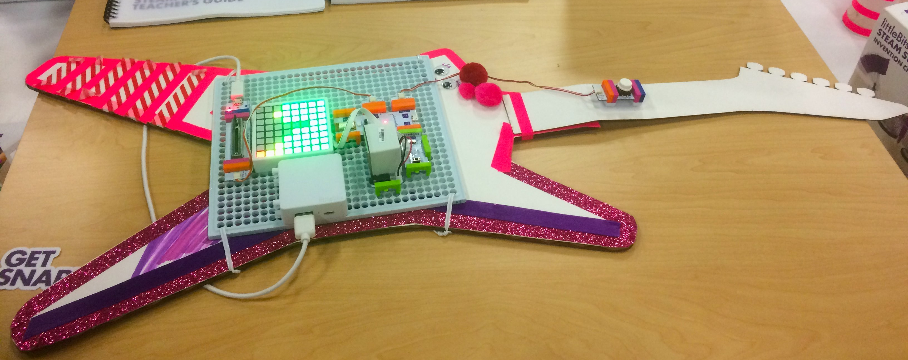
is for everyone!
Computer Science

Slide 3
“The computer is the Proteus of machines. Its essence is its universality, its power to simulate. Because it can take on a thousand forms and can serve a thousand functions, it can appeal to a thousand tastes” (Papert, 1980).
Seymour Papert
http://www.papert.org/

Slide 4
Why Computer Science?
https://code.org/promote
https://youtu.be/VFcUgSYyRPg

Slide 5
“CT is an approach to solving problems in a way that can be implemented with a computer. Students become not merely tool users but tool builders. They use a set of concepts, such as abstraction, recursion, and iteration, to process and analyze data, and to create real and virtual artifacts. CT is a problem-solving methodology that can be automated and transferred and applied across subjects.”
from Computer Science K-8

Slide 6
CT is a problem-solving process that includes (but is not limited to) the following characteristics:
formulating problems in a way that enables us to use a computer and other tools to help solve them;
logically organizing and analyzing data;
representing data through abstractions such as models and simulations;
automating solutions through algorithmic thinking (a series of ordered steps);
identifying, analyzing, and implementing possible solutions with the goal of achieving the most efficient and effective combination of steps and resources; and
generalizing and transferring this problem-solving process to a wide variety of problems.
It has also led to identification of a number of dispositions or attitudes that are essential dimensions of CT. These dispositions or attitudes include:
confidence in dealing with complexity,
persistence in working with difficult problems,
tolerance for ambiguity,
the ability to deal with open-ended problems, and
the ability to communicate and work with others to achieve a common goal or solution.

Slide 7
Ozobots
https://youtu.be/_2s3xxEbnrA
https://youtu.be/KX1wuSiwViA
https://www.youtube.com/watch?time_continue=23&v=fwIrAzZfvRc

Slide 8
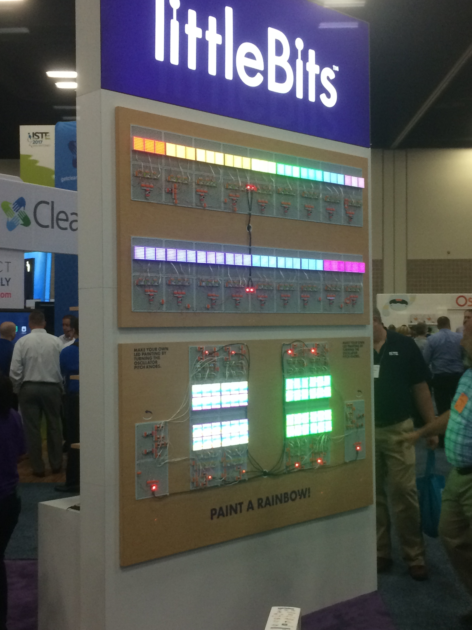
littleBits
https://youtu.be/YguB-keZ4Tk?t=1m51s
http://littlebits.cc/lessons?type=lesson&sort=recent&page=1&per_page=12#browse

Slide 9
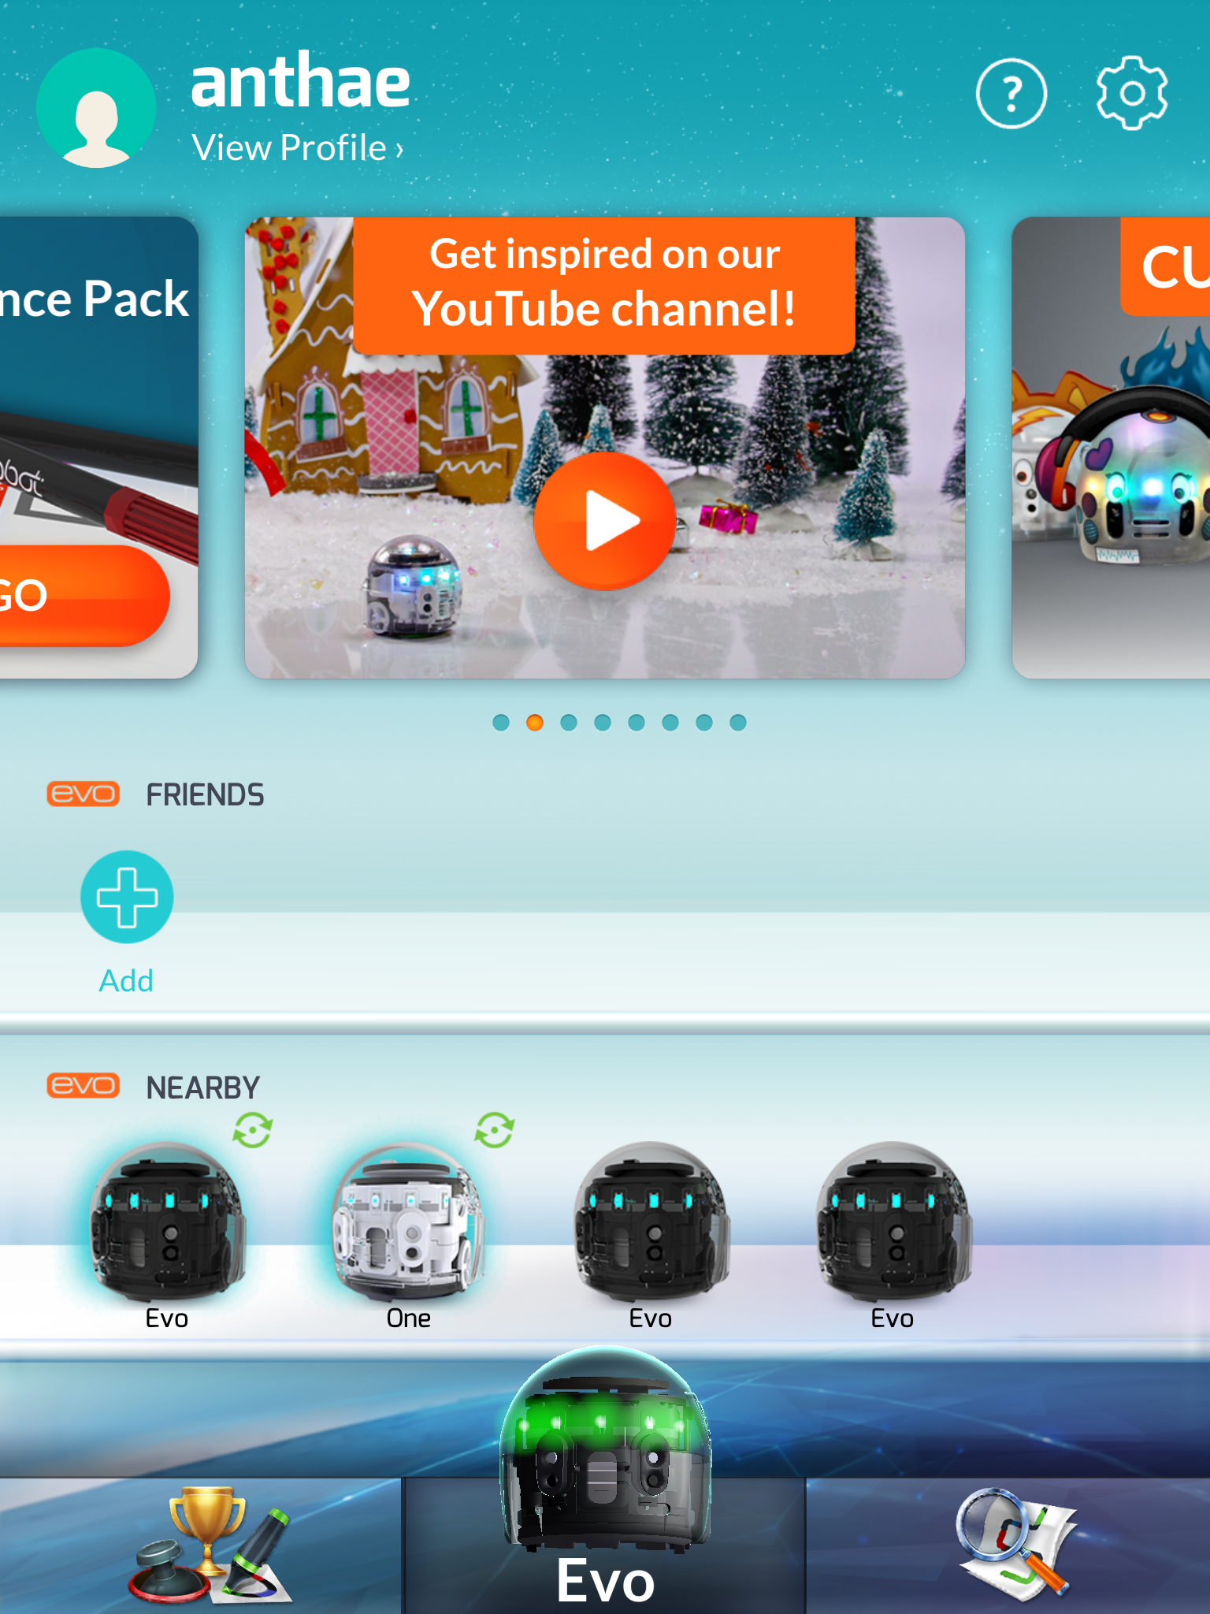

Slide 10
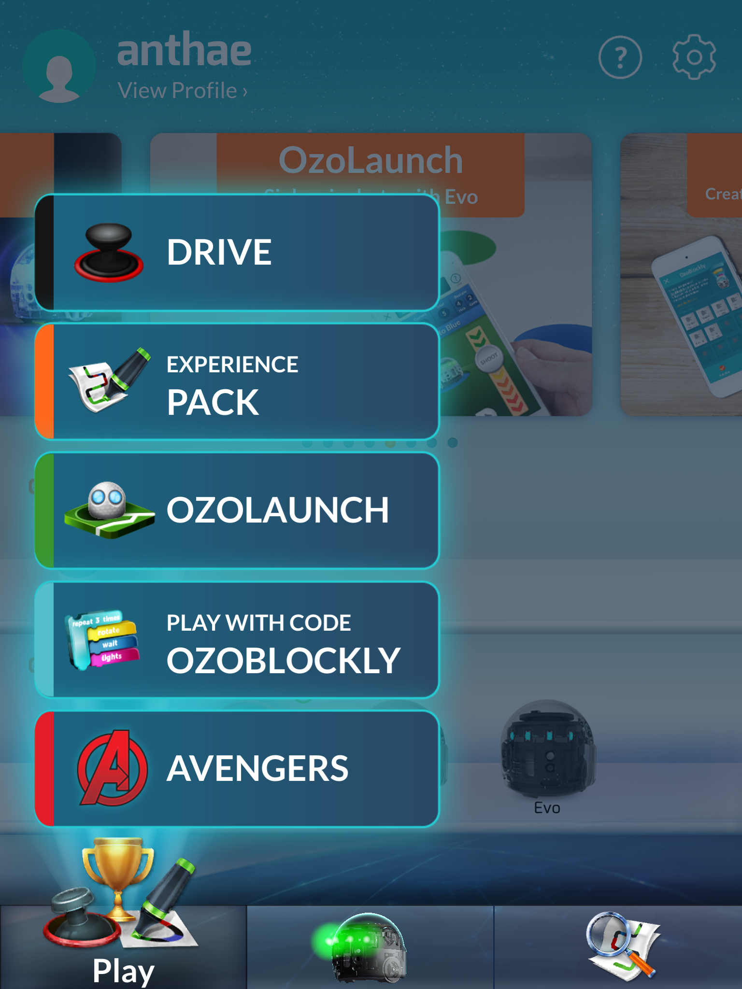

Slide 11
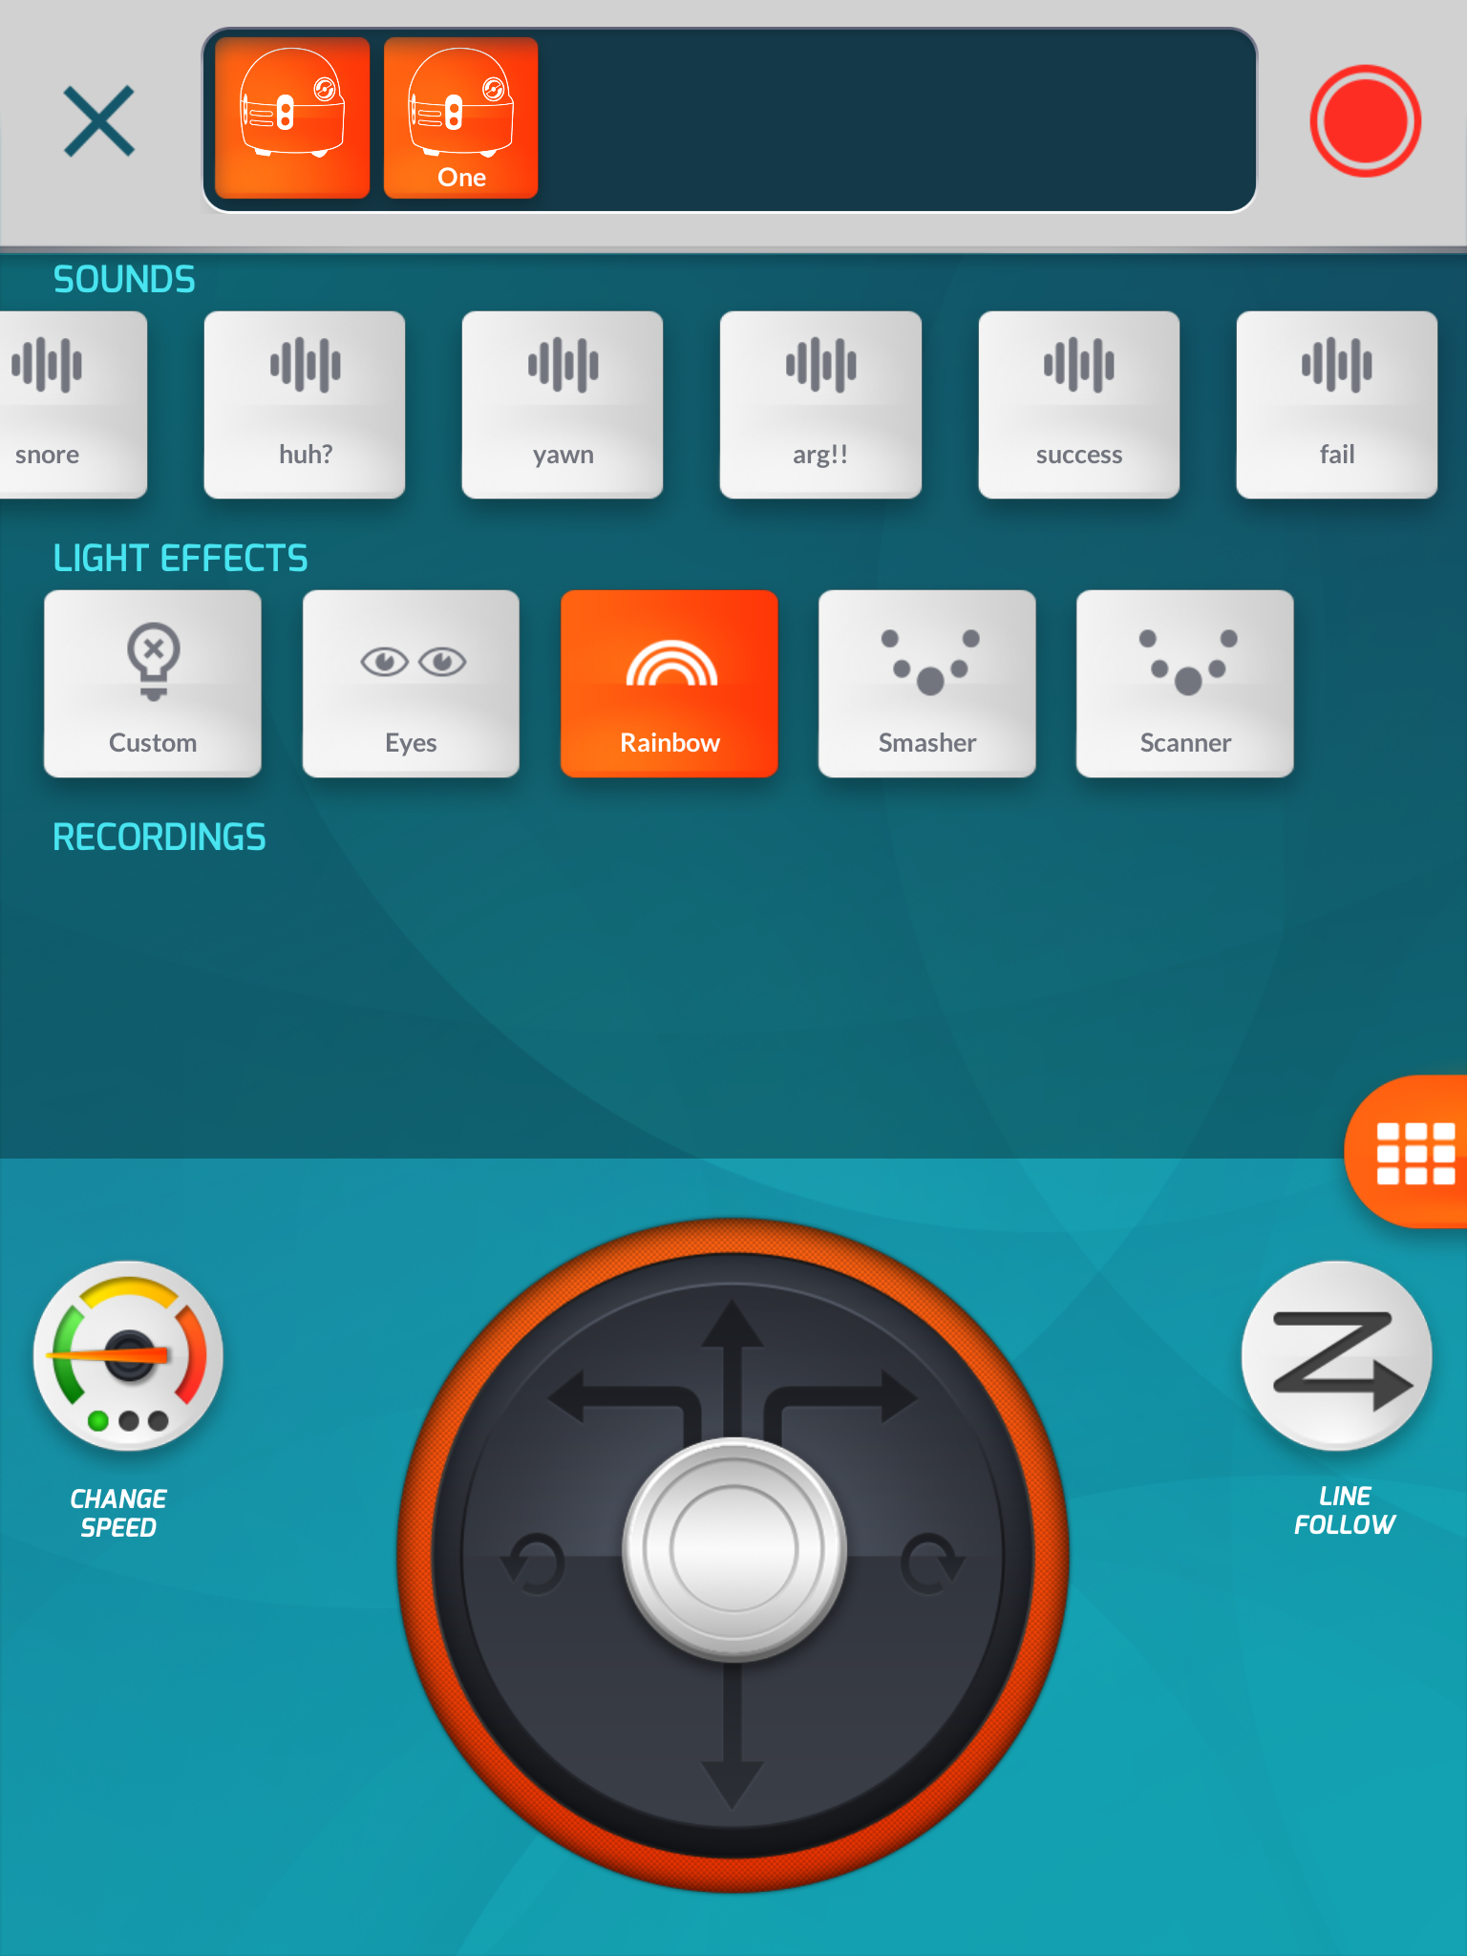

Slide 12
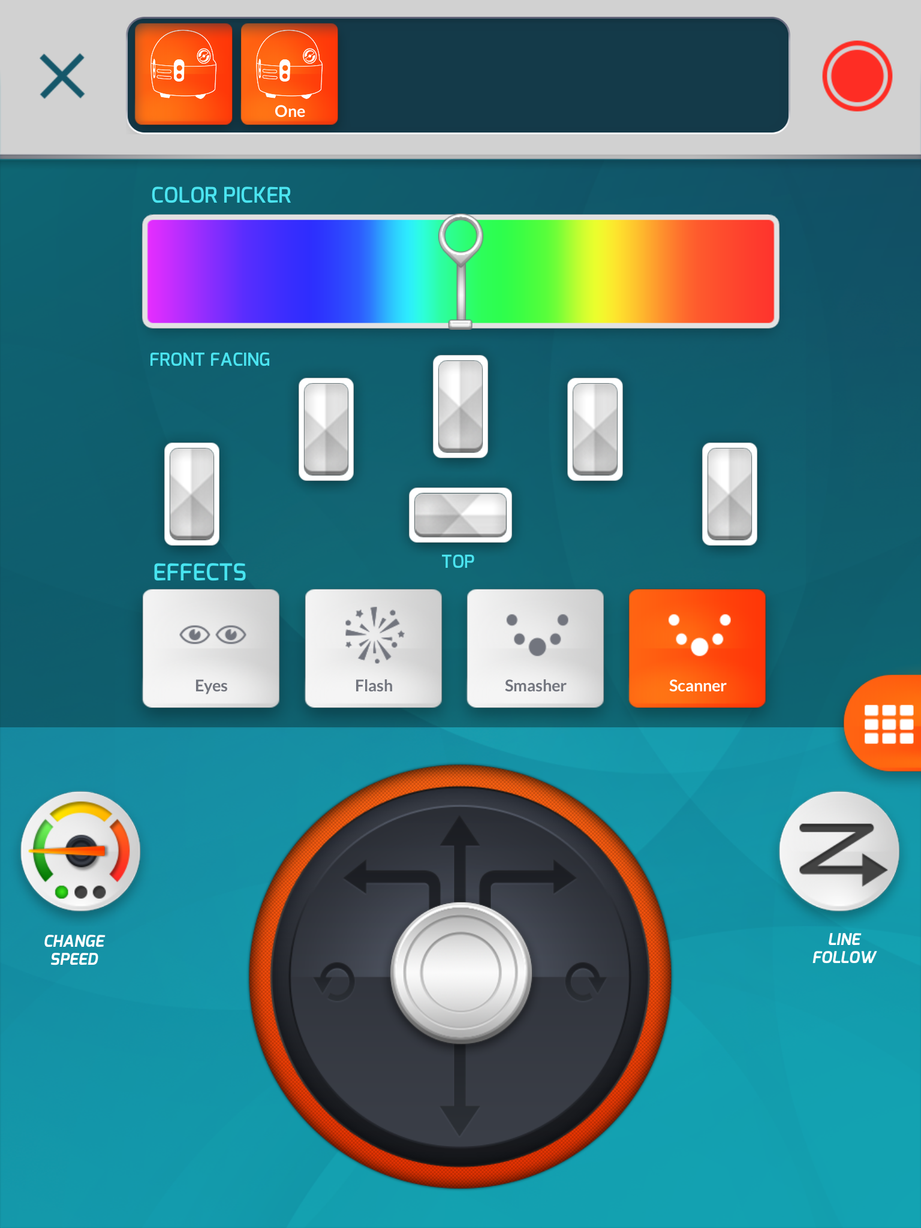

Slide 13
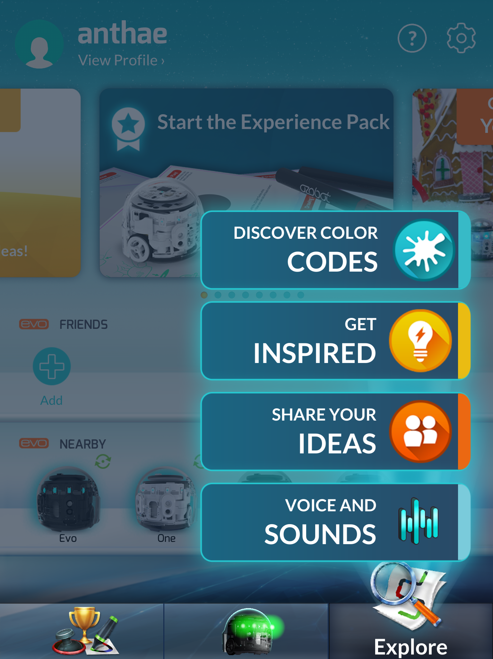

Slide 14
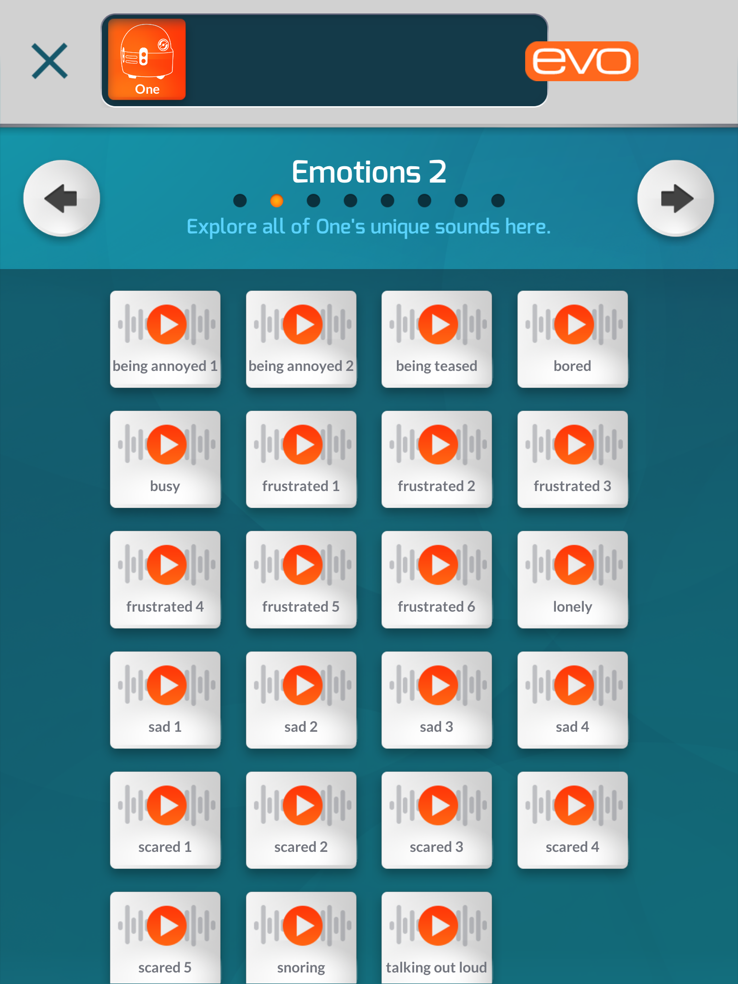

Slide 15
Our Team
Antha Holt aholt@mccleary.wednet.edu
Twitter: @GriffyHolt
Tina Lusby tlusby@mccleary.wednet.edu
Anna Katzen akatzer@mccleary.wednet.edu
School website: www.mccleary.wednet.edu

